Slide 1
Deep Learning Foundations
Darshana Shah
Lecturer
Week 3

Slide 3
CNN
CNN is an abbreviation of Convolutional Neural Networks
CNN is a type of neural network and very similar to the way we process or classify images – that is we determine the features and then process
CNN processes the images is a very similar way
Used for processing images as it is highly accurate and can work without human supervision
Convolutional Neural Network
Output Label (Image classification)
Input Image

Slide 4

CNN

Slide 5

CNN

Slide 6
Layers of a CNN
Below are the layers of a CNN:
Step 1 – Convolution
Step 2 – ReLU Layer
Step 3 – Pooling (Max Pooling)
Step 4 – Flattening
Step 5 – Full Connection

Slide 7
Step 1 – Convolutional Layer
The first layer of a CNN is always the convolutional layer
Responsible for identifying a set of features from the input image
A window representing a feature is ‘dragged’ over the image and used to compare how each segment of the image matches up to the feature
Convolutional layer receives multiple images as inputs and analyses how well each image corresponds to the desired feature
Feature map tells you where the feature is present in the image
Higher value -> stronger correspondence with the feature
Note: The terms feature and filter are interchangeable

Slide 8
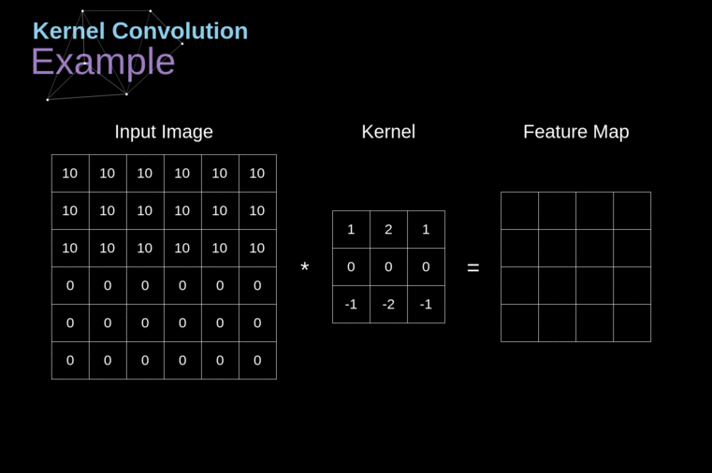
Convolution

Slide 9
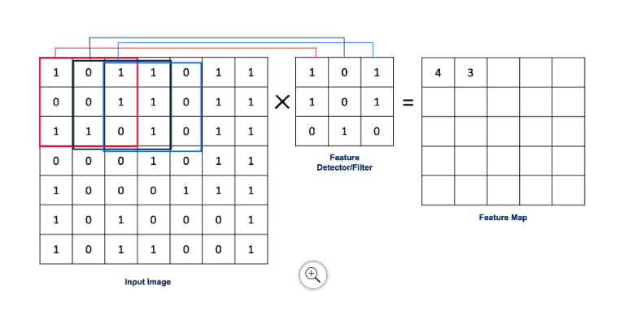
Convolution Operation
This operations finds features of an image using feature detector and then generates a feature map
The feature map preserves the pattern that is important for image recognition
This step mathematically is an integration of two functions or just showing how one function modifies the other function

Slide 10
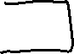
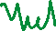
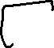
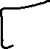
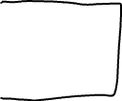
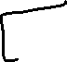
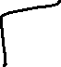
Feature Map
Feature map – Mimic the way we identify objects, by mainly preserving the important features of the object and not necessarily processing every little detail of the object
Create a Convolutional layer by creating multiple filters and multiple feature maps.

Slide 11
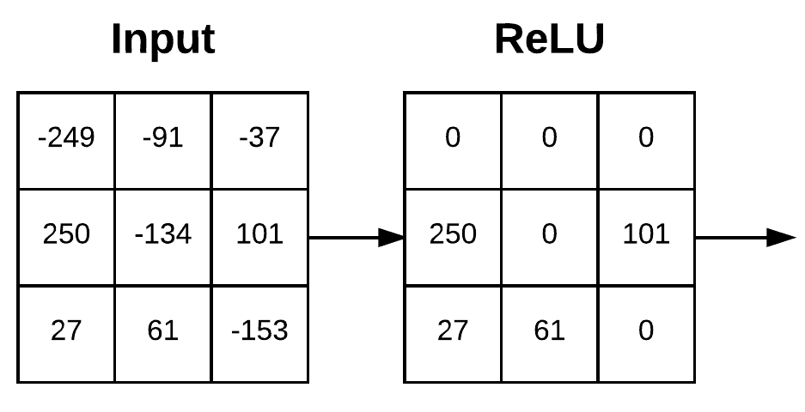
Step 2 – ReLU Layer
We apply the Rectified Linear Unit (ReLU) filter to increase the non-linearity in the image
ReLU correction layer acts as an activation function
Replaces any negative input values with zeros and positive values are left unchanged to ensure that the output does not equal to 0, so now the output is not a linear function of the input anymore
Helps reduce overfitting due to its sparsity, meaning some of the activations in the layer can be zero
Applied after the convolution and before the pooling layer

Slide 12
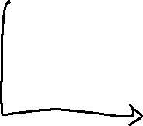
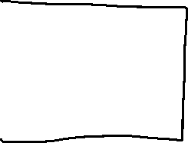
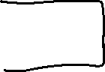
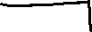


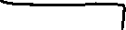


ReLU Layer

Slide 13
Step 3 – Pooling (Max Pooling)
Images can be in different positions and the same object can have different images.
For example, there can be images of many types of dogs.
Another example is photos of you wearing different outfits or in a different location
Neural Network must be trained to identify objects even when there is some distortions or spatially placed differently.
Pooling is added to preserve features but, special dependency is removed as well as the feature map reduces in size for efficiency.
Pooling removes unnecessary features and preserves the important ones, avoiding the problem of overfitting

Slide 14
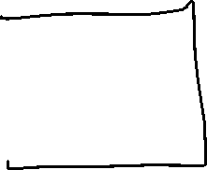
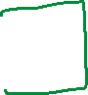


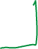
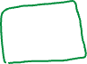
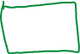


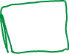
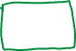

Max Pooling

Slide 15
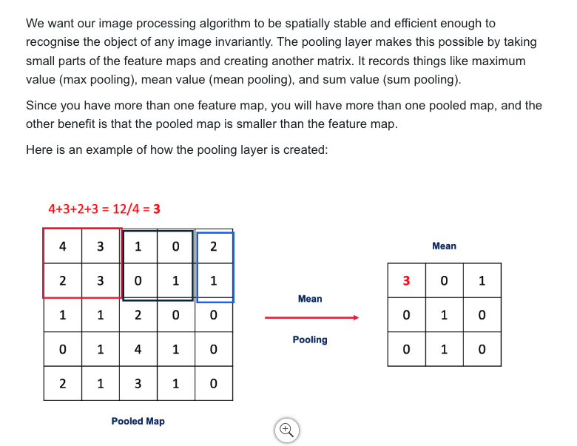
Mean Pooling

Slide 16
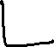




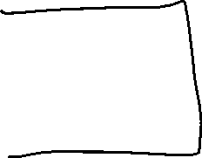
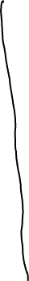
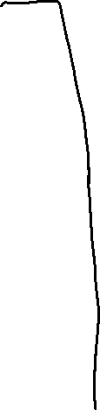



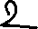

Step 4 – Flattening
Flatten the 2D mean/max/sum pooled map to a single-dimension flat vector
16

Slide 17
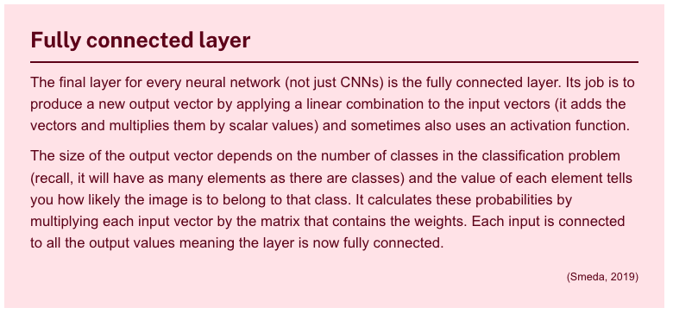
Step 5 – Full Connection

Slide 18
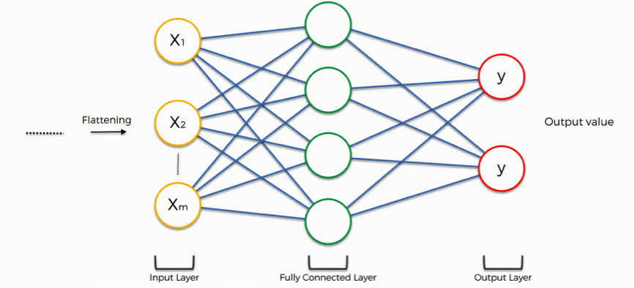
Full Connection
Image source : https://www.superdatascience.com/blogs/convolutional-neural-networks-cnn-step-4-full-connection

Slide 19
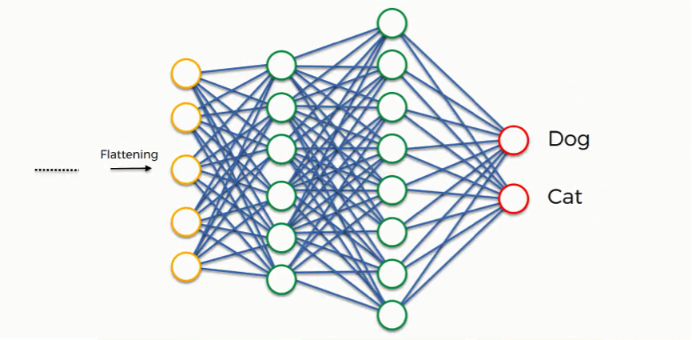
Full Connection
Image source : https://www.superdatascience.com/blogs/convolutional-neural-networks-cnn-step-4-full-connection

Slide 20
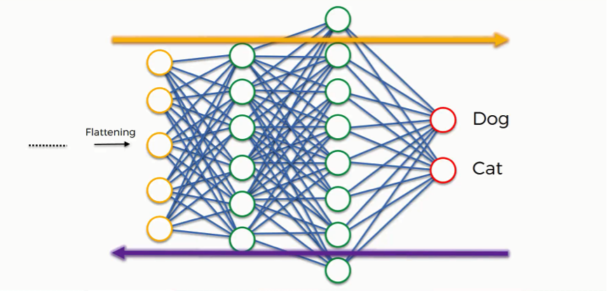
Full Connection

Slide 21
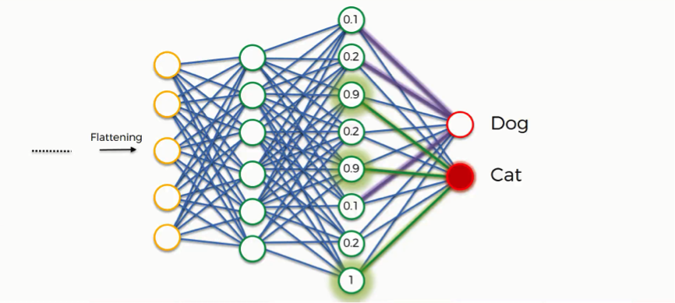
Full Connection

Slide 22
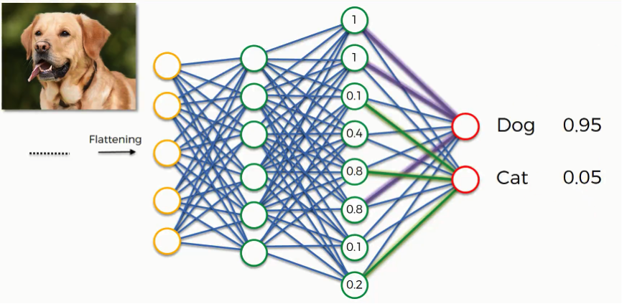
Full Connection

Slide 23
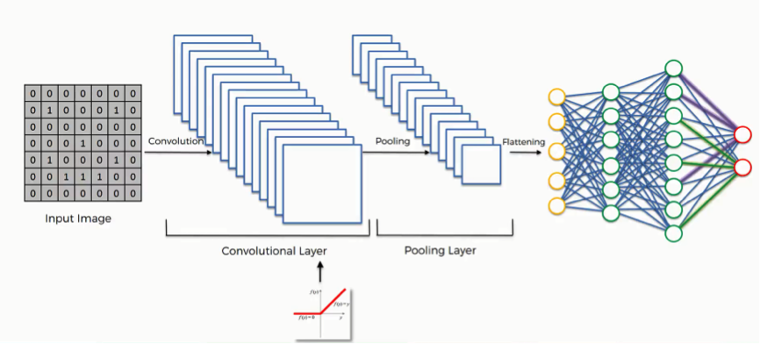
Full View CNN

Slide 24
Demonstration
CNN demonstration using TensorFlow and Keras

Slide 25
Computer Vision
CNN is a vital component of Computer Vision
Helps a model break an image down into pixels and generate feature maps for the model to draw meaning from
Applications:
Image classification
Object detection
Object tracking
Content-based image retrieval

Slide 26
Biometric Authentication and CNN
Examples are retinal scanners and facial recognition
Goal of CNN in biometric authentications is to have low FARs (False Acceptance Rates) and low FRRs (False Rejection Rates)

Slide 27
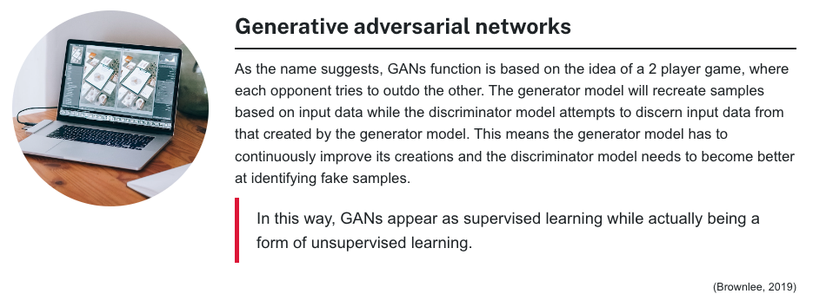
GANs

Slide 28
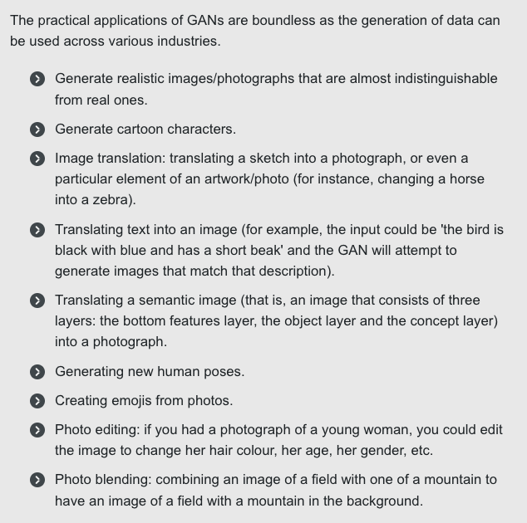
Applications of GANs

Slide 29
GAN in TensorFlow
Generating training data
Implementing the generator and discriminator
Adversarial training

Slide 30
RNNs
Recurrent Neural Networks (RNNs) are neural networks which are designed to deal with data that is sequential or temporal.
They use the sequential nature of the data to identify patterns and make predictions based on those characteristics.
RNNs are particularly powerful in areas such as natural language processing (NLP), image captioning and speech recognition, and are often taught with datasets based on semantics and linguistics.

Slide 31
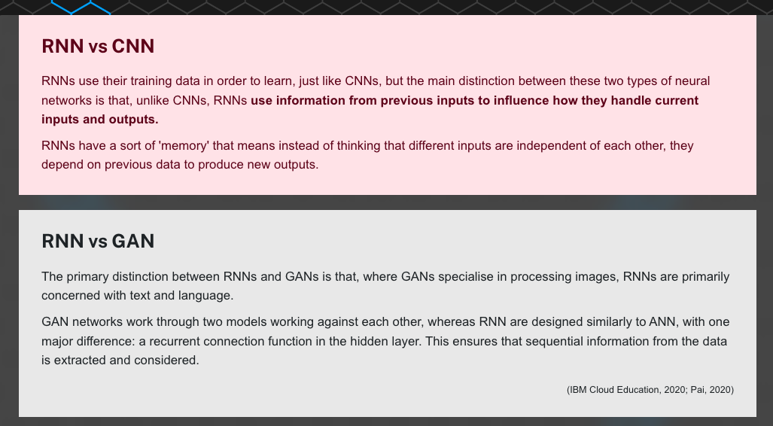
RNN vs CNN vs GNN

